Slide 1
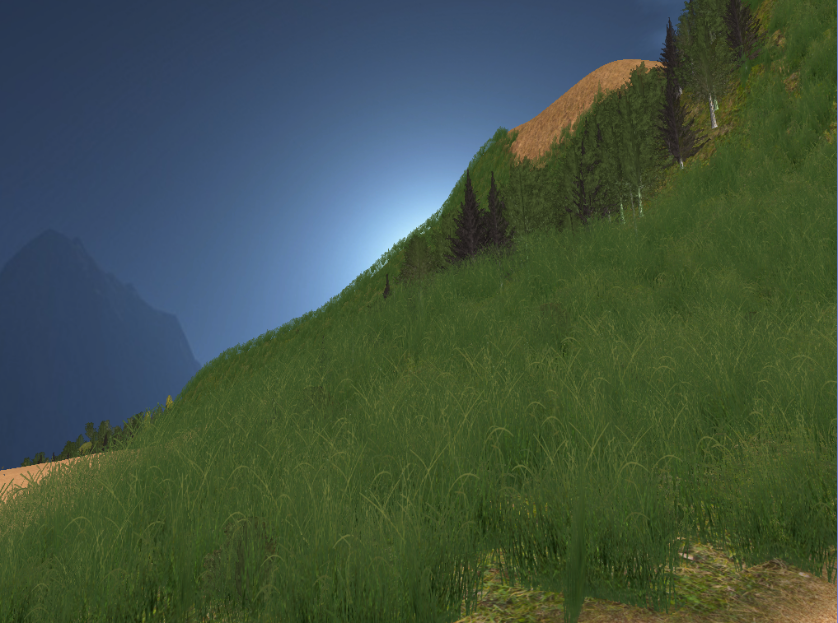
Procedural Terrain
Sebastian Weiss

Slide 2
Why Procedural Terrain?
Large area → exploration
Small details → interest
Endless worlds (e.g. Minecraft)
Time saving for artists
Procedural generation
Artistic control

Slide 3
Overview
Polygonal Map: initial shape
Terrain Features: tune the terrain
Water Erosion: increase realism
Vegetation: add life

Slide 4



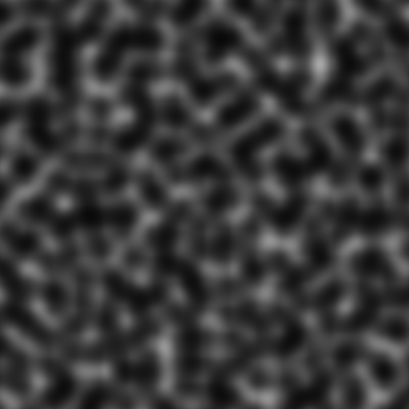
Perlin Noise The programmer’s friend

Slide 5
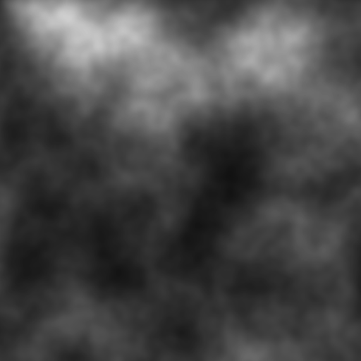

Slide 6
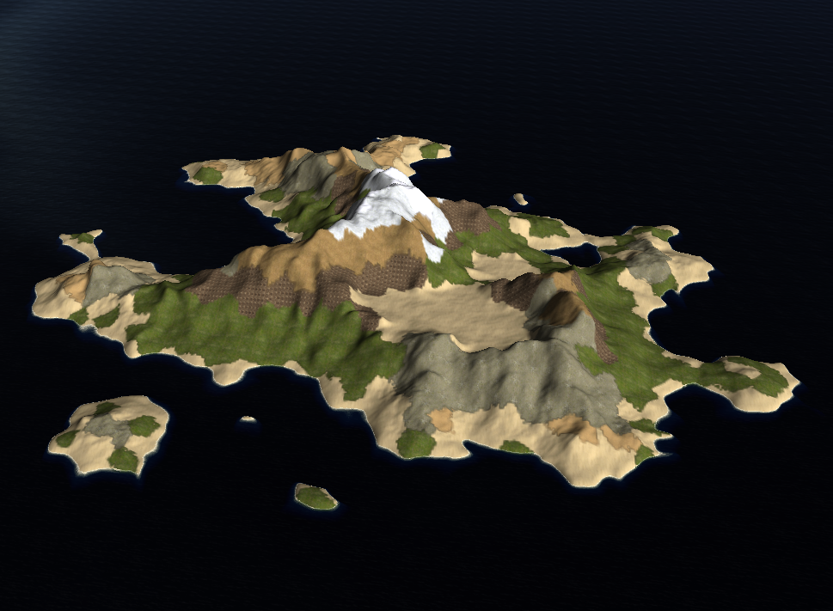
Step 1: Polygonal Map

Slide 7
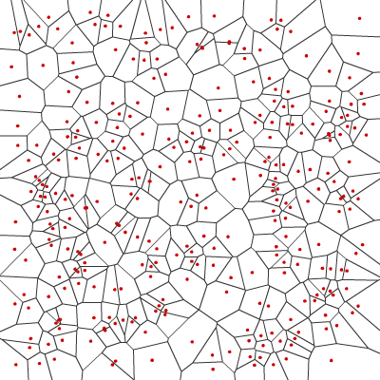
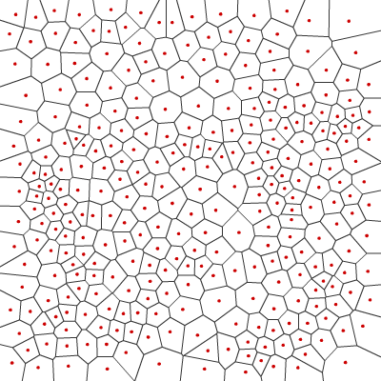
Voronoi diagram

Slide 8
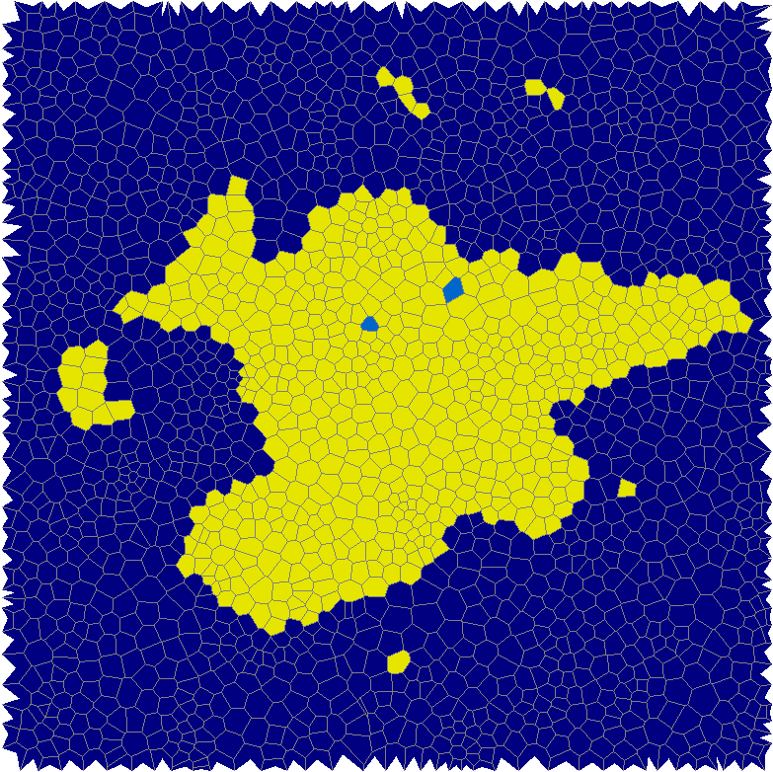
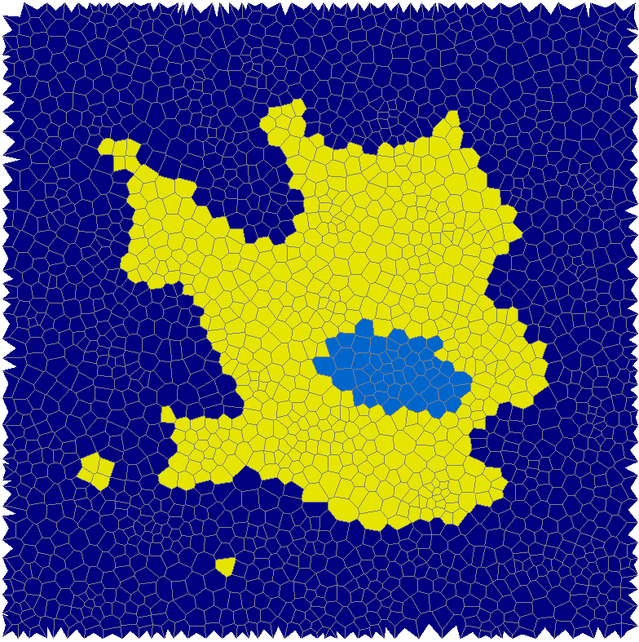
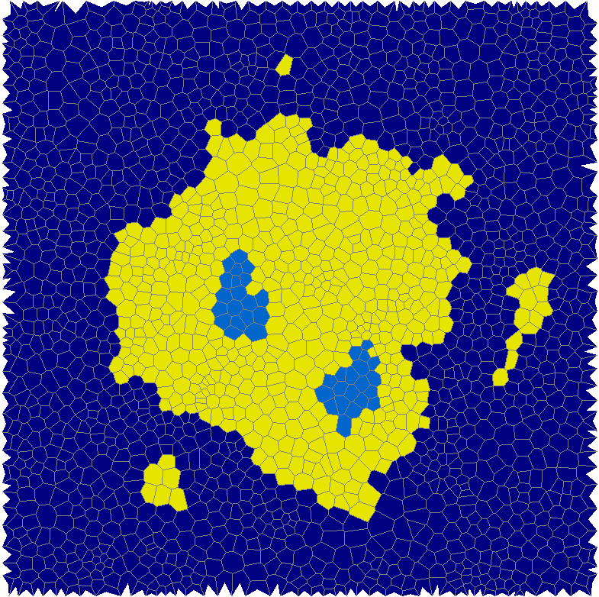
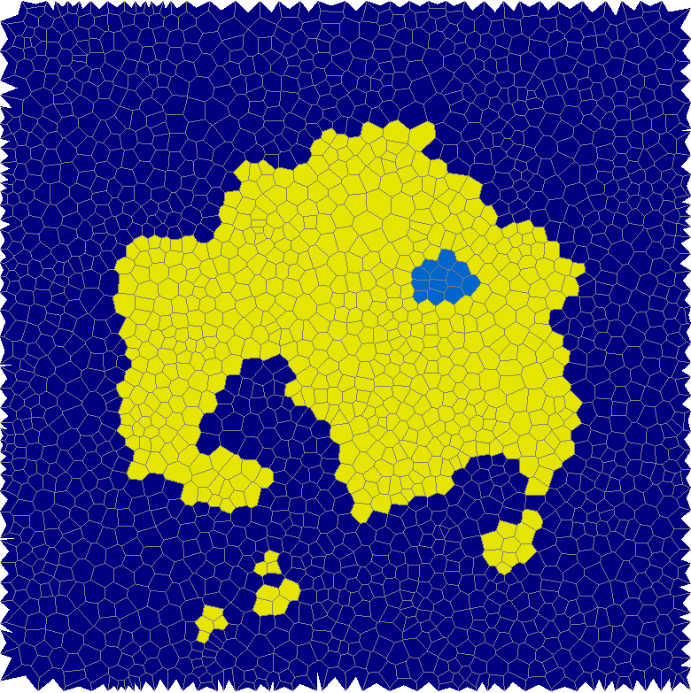
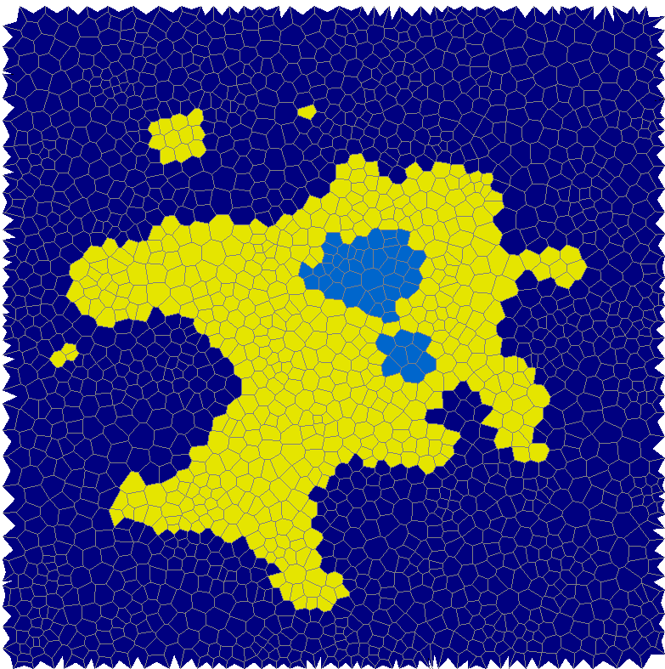
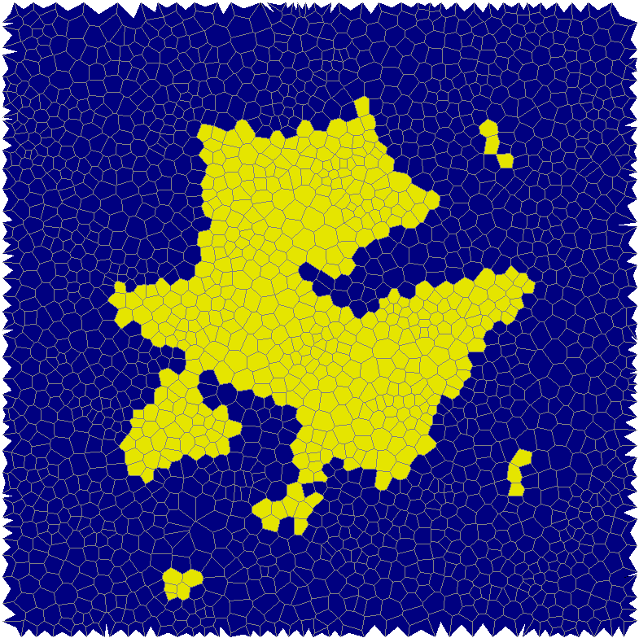
Island shape Perlin noise + distance to the center

Slide 9
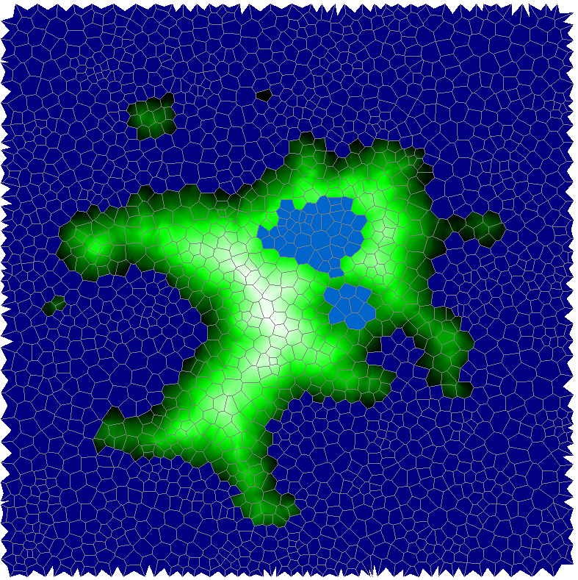
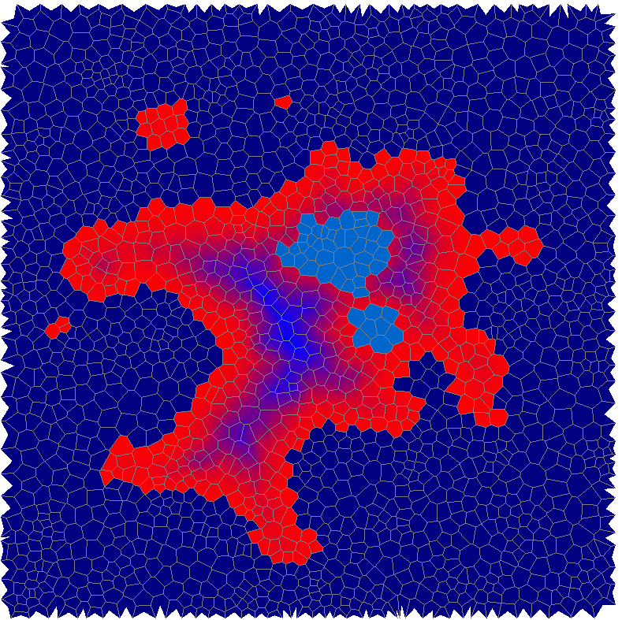
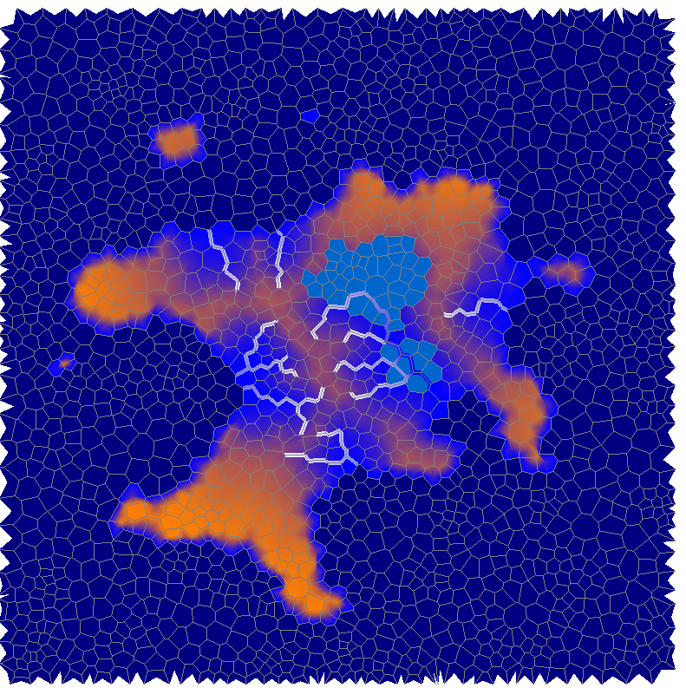
Elevation, Temperature, Moisture

Slide 10
Create height map

Slide 11
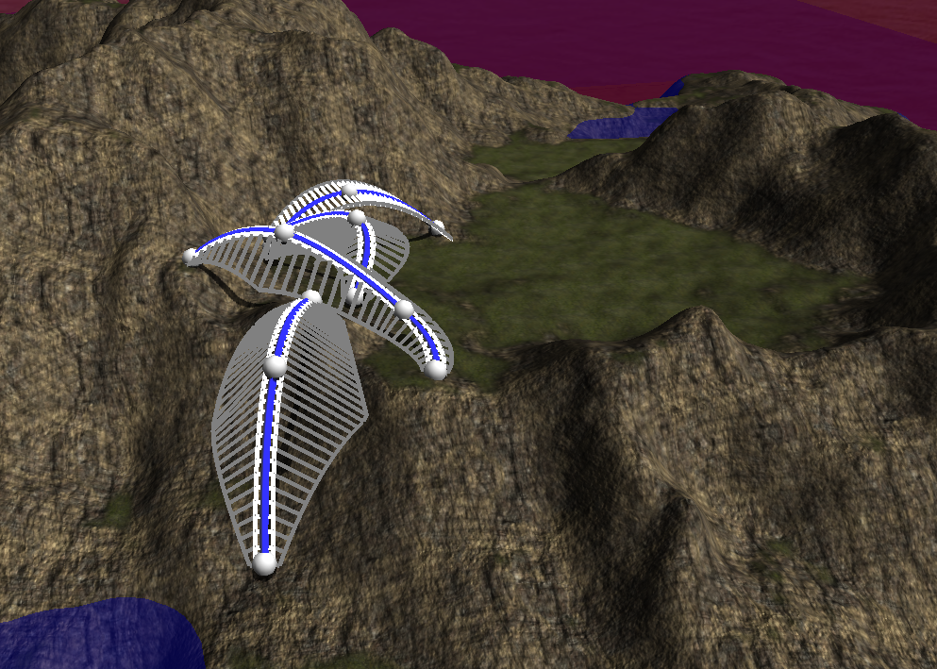
Step 2: Terrain Features

Slide 12
Feature Curves
Interpolation between Control Points
Elevation
Plateau size
Slope size
Slope angle
Smoothing influence

Slide 13
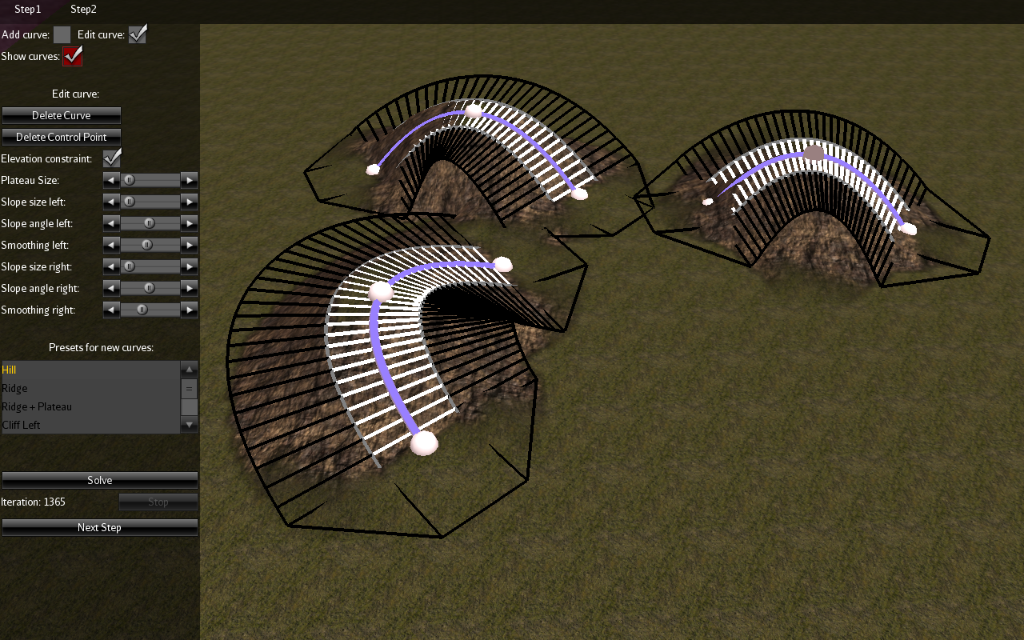
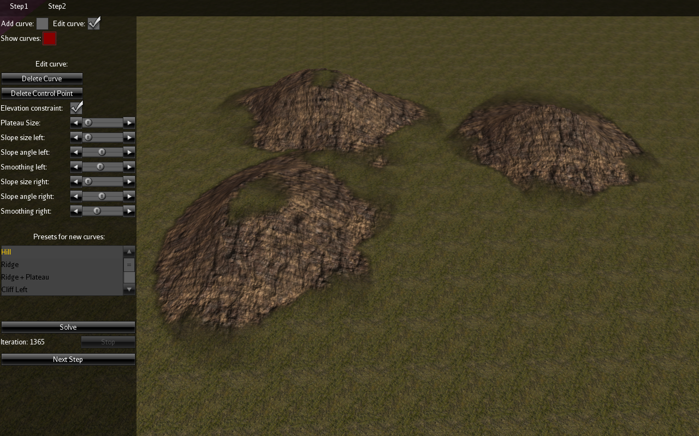
Hills only elevation and smoothing, no slope

Slide 14
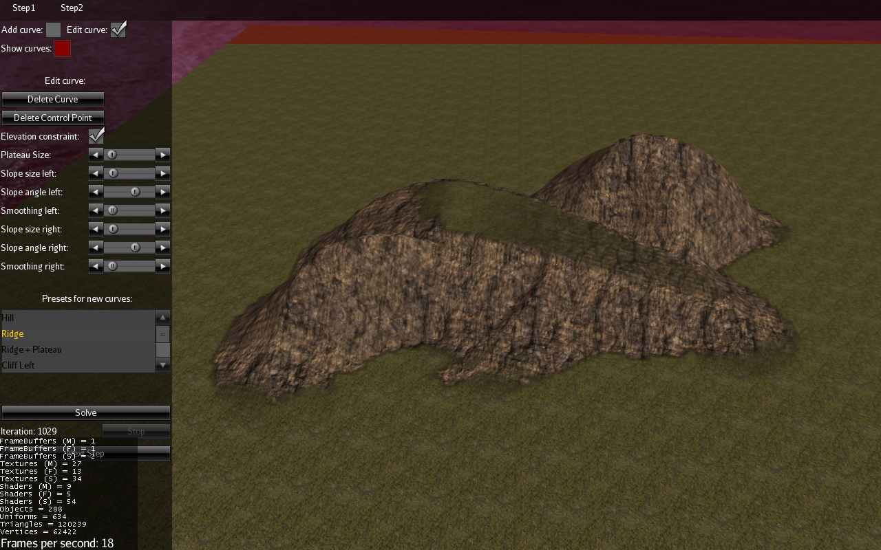
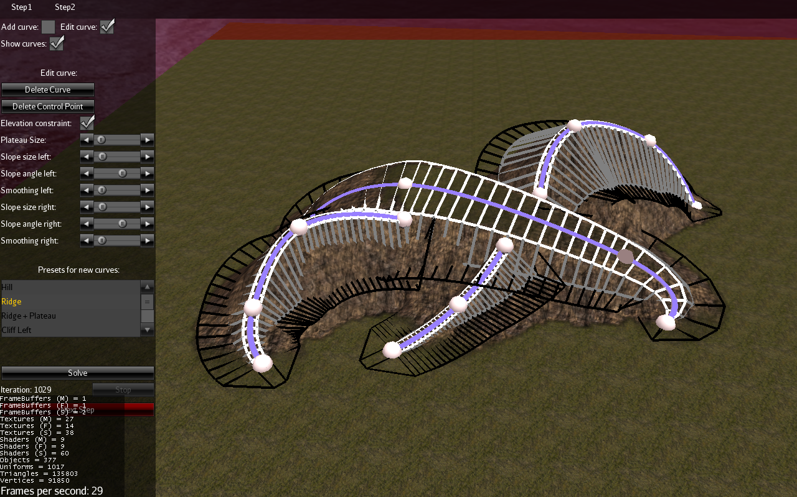
Ridge lines 45° slope

Slide 15
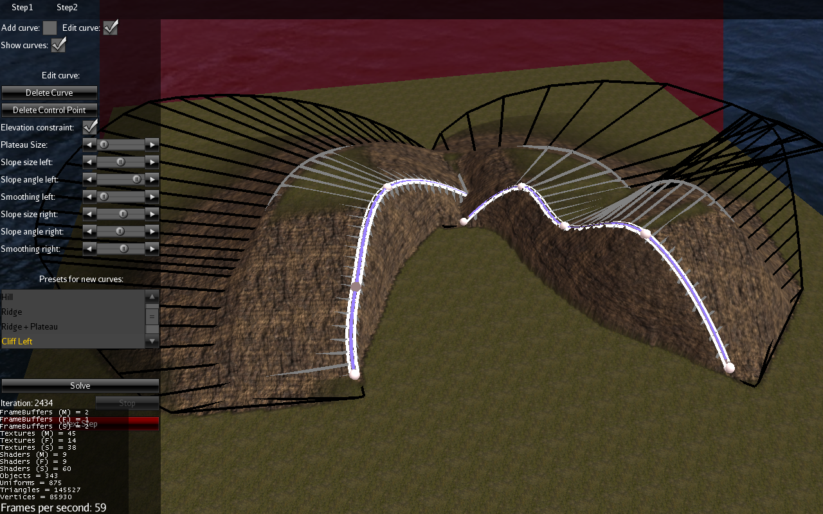
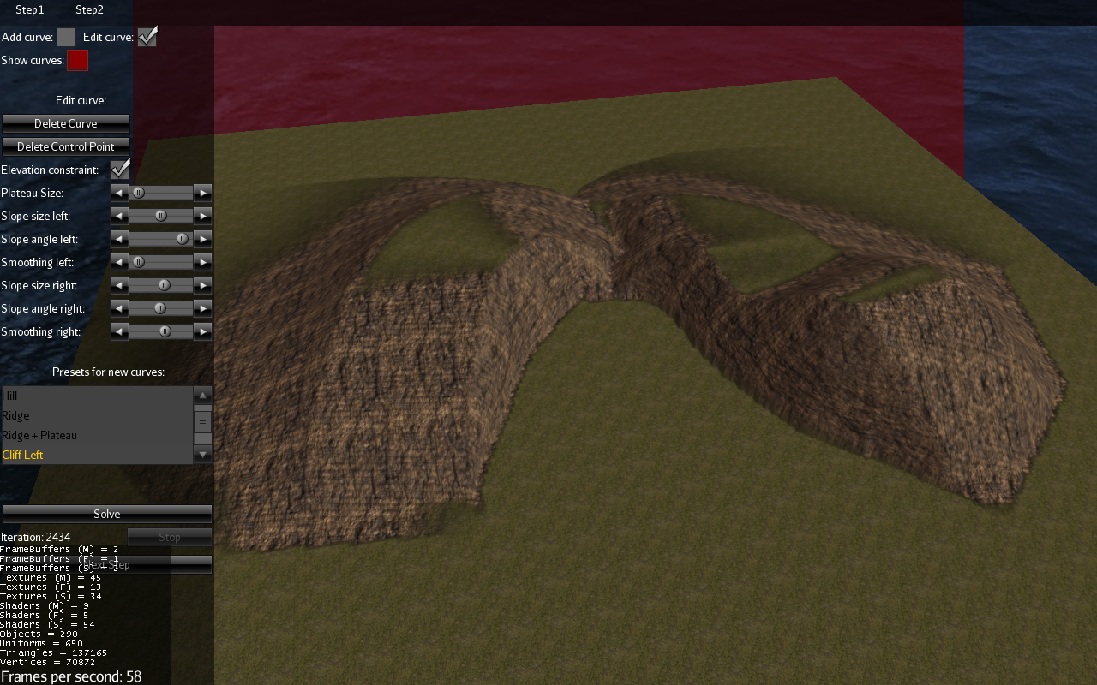
Cliffs 90° slope at one side, long smoothing at the other side

Slide 16
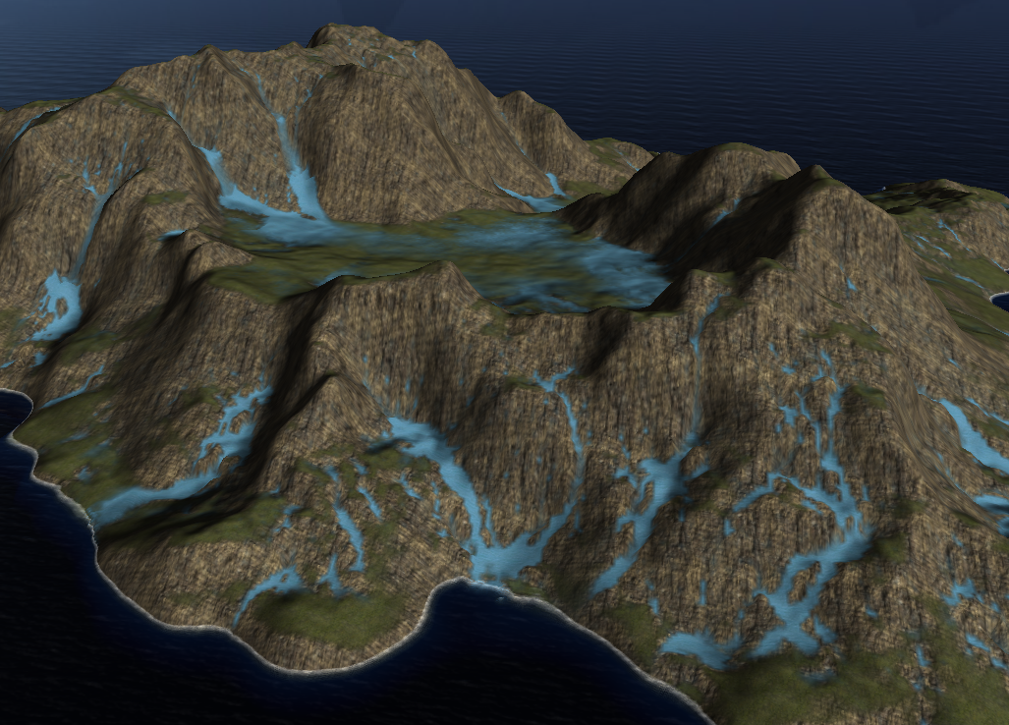
Step 3: Hydraulic Erosion

Slide 17
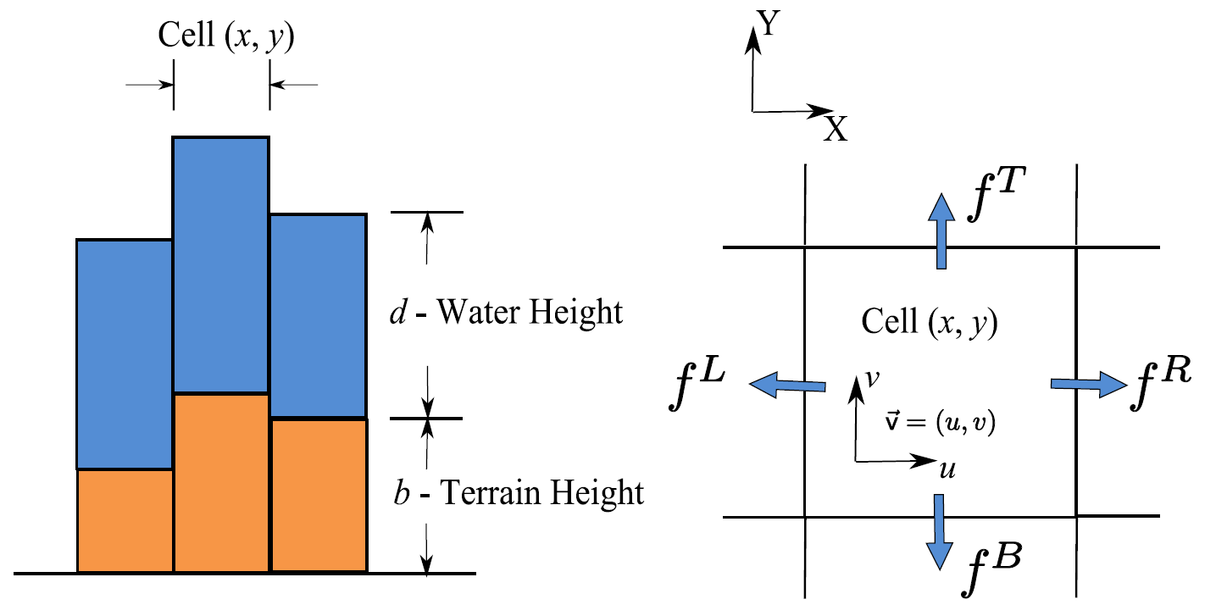
Pipe model
Move water from one cell to another when the height is lower

Slide 18
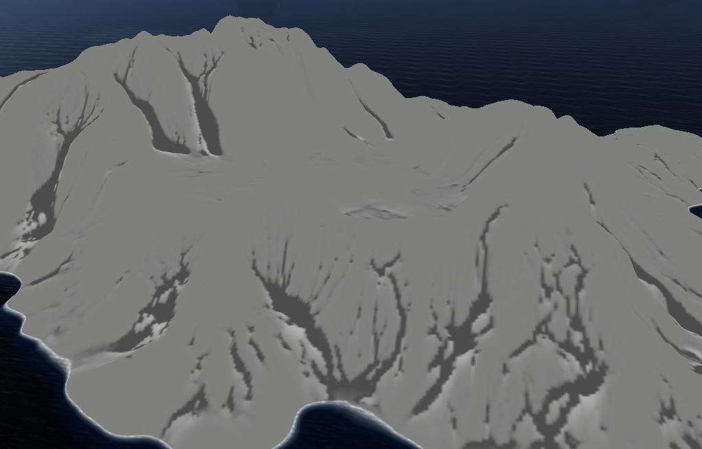
Erosion Water erodes sediment on steep slopes Sediment is deposited on flat areas

Slide 19
<Movie>

Slide 20
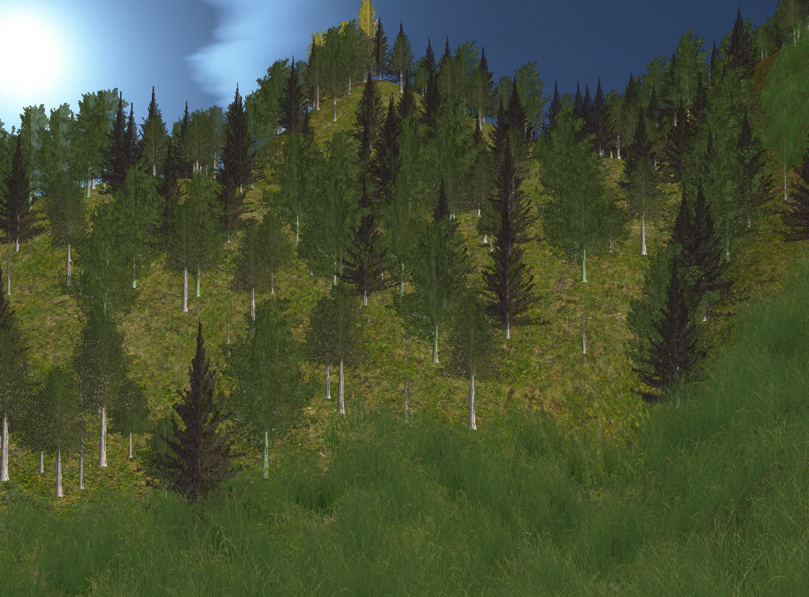
Step 4: Vegetation

Slide 21
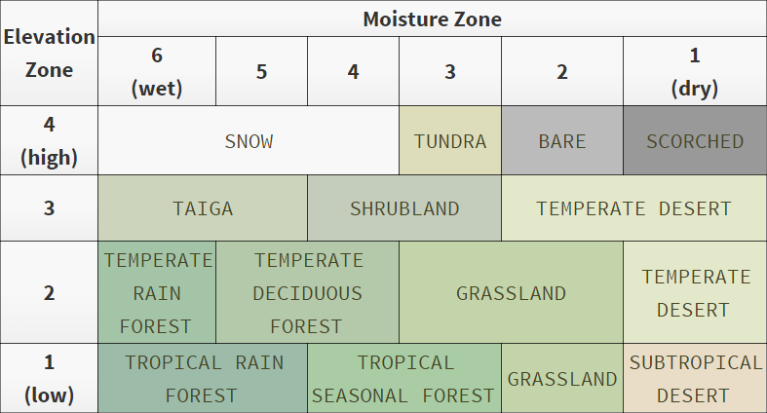
Assign biomes
Texture
Grass density
Tree types

Slide 22
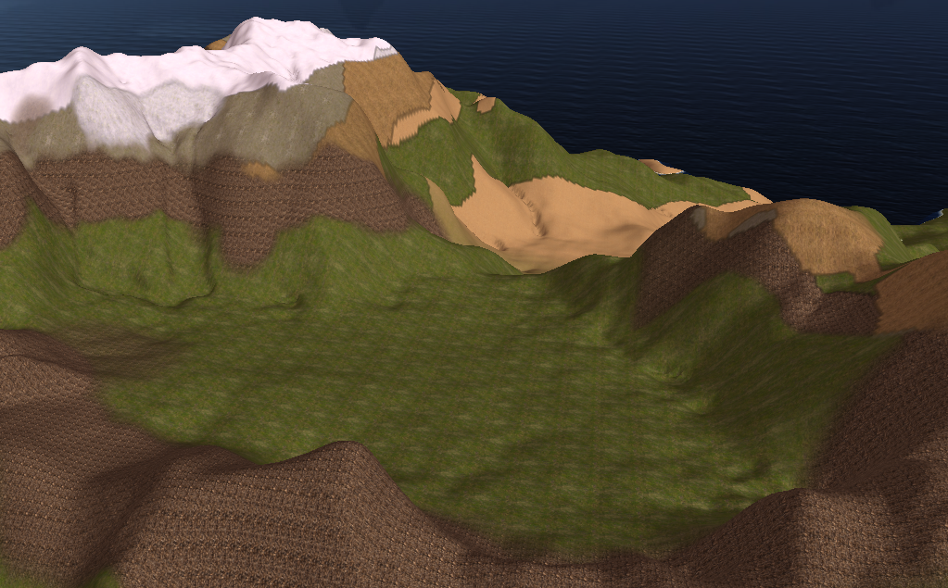
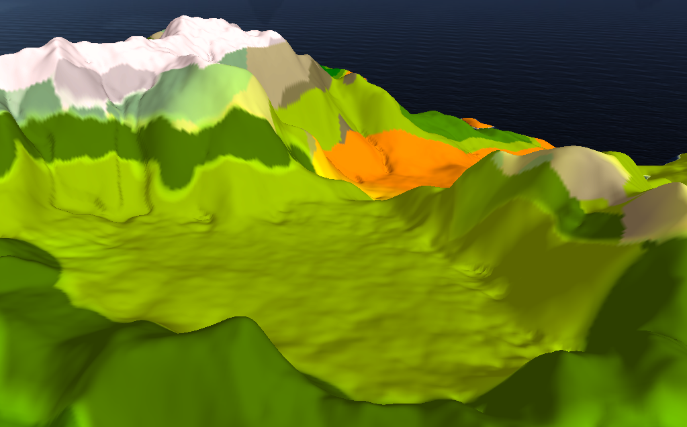

Slide 23
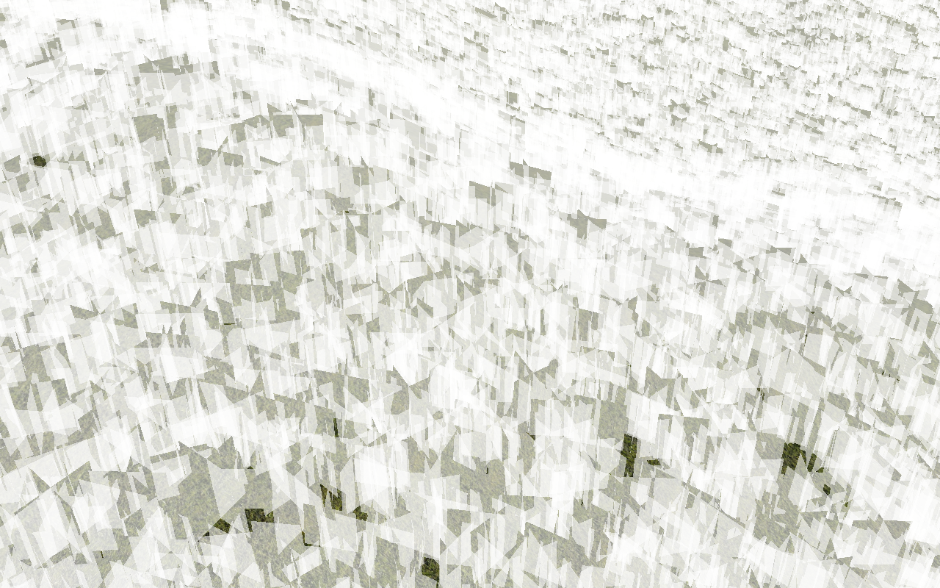
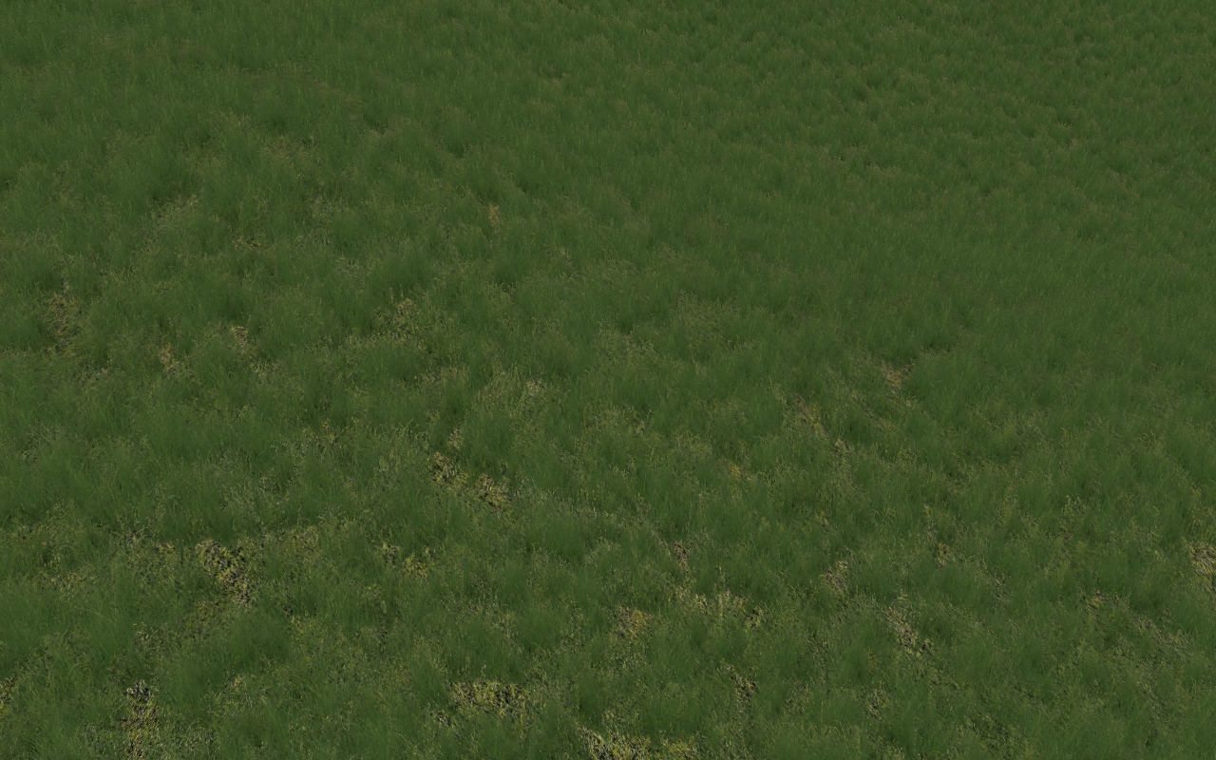
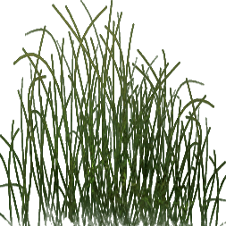
Grass quads with texture

Slide 24
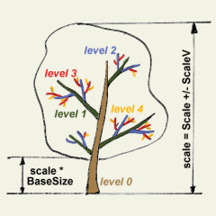
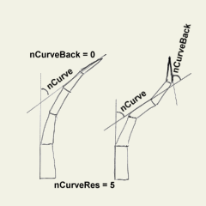
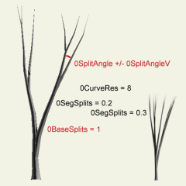
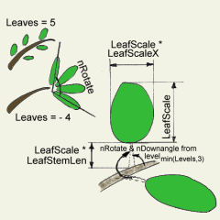
Trees
Define trees recursively
Specify properties for every layer:
Radius, scaling
Curvature
Branching, splitting
Textures

Slide 25
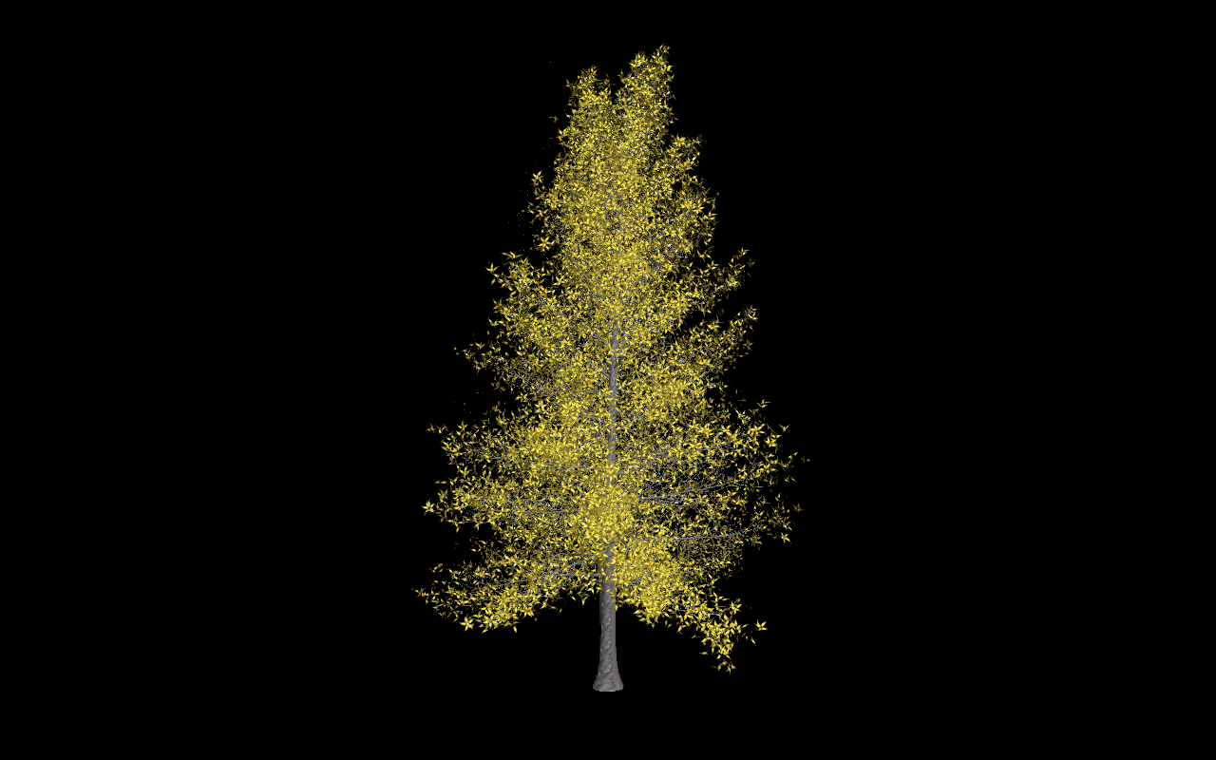
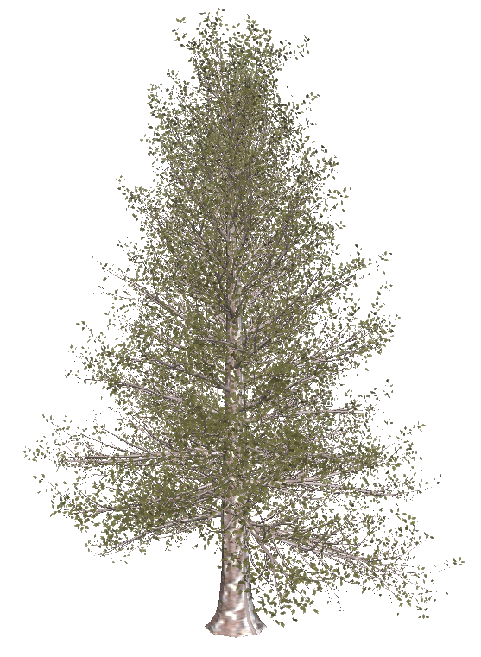
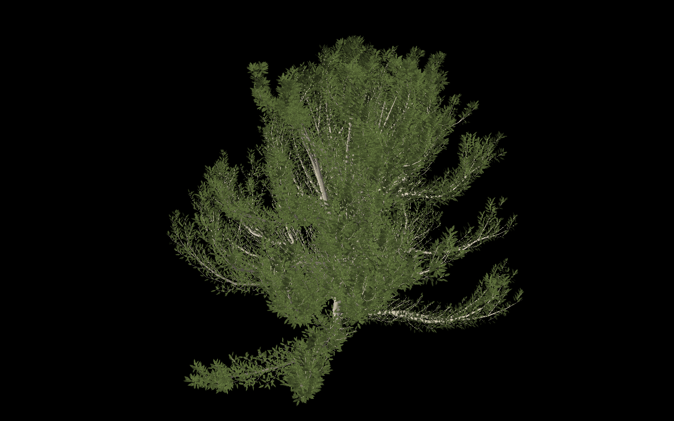

Slide 26
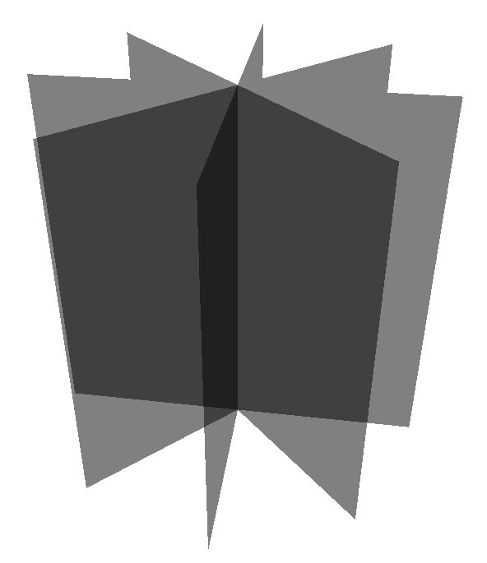
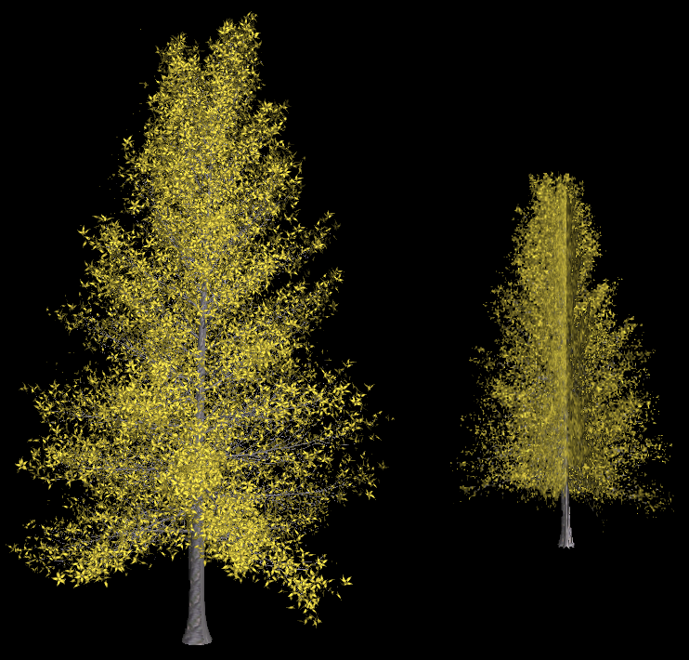
Problem: too many polygons →Use impostors for distant rendering

Slide 27
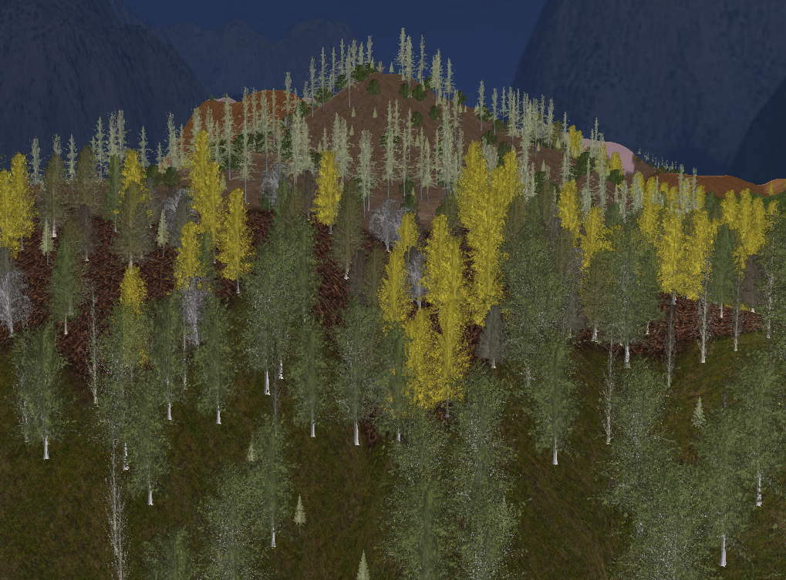
Thanks for your attention

